Slide 1
Respiratory Failure
Mulualem Sitot (BSc, MSc in Anesthesia)
Assistant Professor, Department of Anesthesia
Addis Ababa University

Slide 2
Outlines
Objectives
Introduction
Regulation of Breathing
Pulmonary Gas Exchange
Definition of Respiratory Failure
Causes
Assessment
Management

Slide 3
Objectives
At the end of this session, you will be able to:
discuss how breathing is regulated
describe pulmonary gas exchange
define respiratory failure/ventilatory failure
explain the differences between specific types of respiratory failure/ventilatory failure

Slide 4
Introduction
Respiratory care is specifically focused on
the assessment,
diagnostic evaluation,
treatment, and care of patients with heart and lung problems.
A major focus of critical respiratory care is the treatment and support of patients in respiratory failure.
Respiratory failure can be life threatening, and it must be promptly recognized and appropriate action must be taken.

Slide 5
Interactive question 1
What is Respiratory failure?
It is broadly defined as an inability of the heart and lungs to provide adequate tissue oxygenation and/or carbon dioxide removal.
Notes:
Respiratory failure is broadly defined as an inability of the heart and lungs to provide adequate tissue oxygenation and/or carbon dioxide removal.

Slide 6
Interactive question 2
What is respiration?
Respiration: the exchange of O2 and CO2 across the lung (i.e., external respiration) and at the tissue level (i.e., internal respiration).
What components are required for normal respiration to occur?
Notes:
Respiration refers to the exchange of oxygen and carbon dioxide across the lung (i.e., external respiration) and at the tissue level (i.e., internal respiration).

Slide 7
Introduction…
Normal respiration requires five separate components.
Nervous system- dorsal and ventral nuclei of respiratory control group, their afferent and efferent nuclei
Musculature- diaphragm, accessory muscles and chest wall
Airways- up to the terminal bronchiole
Alveolar units
Vasculature

Slide 8
Cont.…
Normal aerobic metabolism produces carbon dioxide and consumes oxygen.
Thus, O2 must be transported to the body’s tissues for consumption and
CO2 must be transported from the tissues to the lungs to be removed.

Slide 9
Four Respiration Processes…
Breathing:
act of inspiring and exhaling that requires energy utilization for muscle work; therefore, it is limited by energy reserves
Ventilation: bulk movement of air into and out of lungs
External respiration: gas exchange between air and blood;
O2 moves from the ambient environment into the pulmonary capillaries, and CO2 leaves the pulmonary capillaries to enter the atmosphere
Internal respiration: gas exchange between blood and tissues
Cellular respiration: O2 use to produce ATP, CO2 as waste
Notes:
Respiration refers to the exchange of oxygen and carbon dioxide across the lung (i.e., external
respiration) and at the tissue level (i.e., internal respiration).

Slide 10
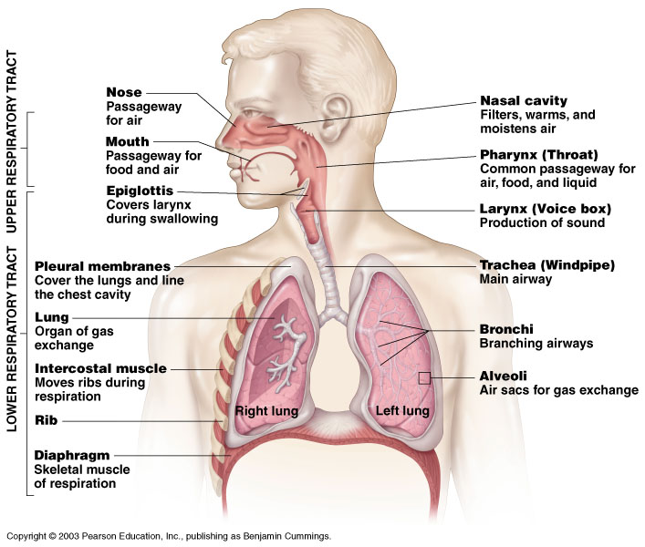
Human Respiratory System
Figure 10.1
Notes:
The terms breathing, ventilation, and respiration are often used interchangeably; however, these terms have distinct meanings.
Breathing: refers to the act of inspiring and exhaling that requires energy utilization for muscle work; therefore, it is limited by energy reserves Ventilation, on the other hand, is the movement of gas in and out of the lungs.
Respiration occurs when energy is released from organic molecules.

Slide 11
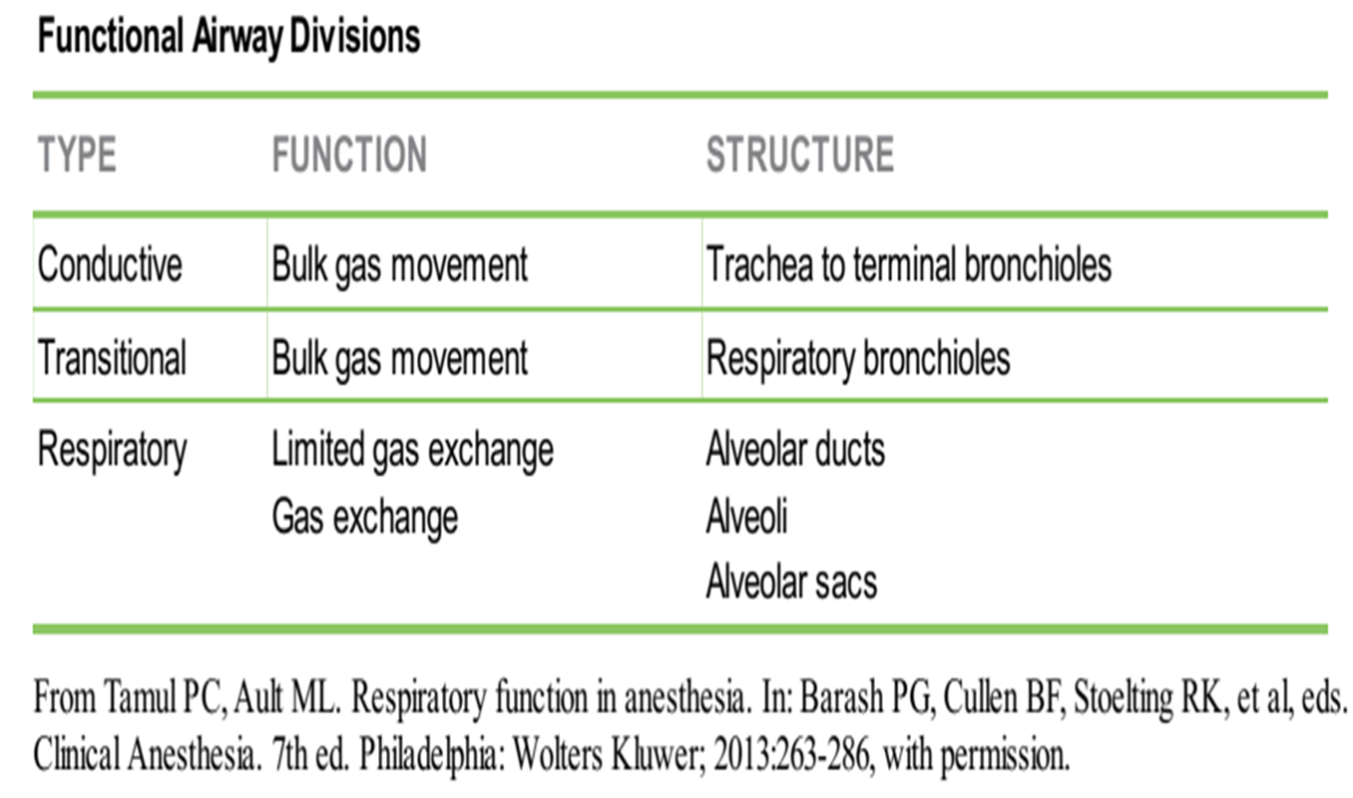
Cont…
The lung parenchyma can be subdivided into functional airway divisions.

Slide 12
Cont…
Only respiratory bronchioles, alveolar ducts, alveoli, and alveolar sacs participate in gas exchange.
The trachea, mainstem bronchi, lobar bronchi, and terminal bronchioles (16th airway generation) are responsible for basic gas transport without exchange.
Respiratory bronchioles and alveolar ducts participate in gas movement and exchange.

Slide 13
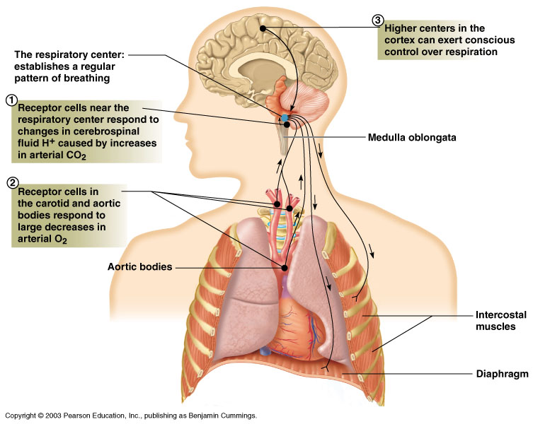
Regulation of Breathing

Slide 14
Regulation of Breathing…
Mechanisms that control breathing are extremely complex,
requiring integration with many parts of the central and peripheral nervous systems
The respiratory center is located in the brainstem (both the pons and medulla).
Breathing depends on a small area of the medulla near the origin of the vagus nerves.
Notes:
Rostral= at or near the front end of the body
dorsal respiratory group (DRG)
ventral respiratory group (VRG

Slide 15
Regulation of Breathing…
Medullary Centers
The medulla oblongata contains the most basic ventilatory control centers in the brain.
Specific medullary areas are primarily active during inspiration or expiration.
The inspiratory centers that reside in the DRG are located in the dorsal medullary reticular formation.
The DRG is the source of elementary ventilatory rhythmicity and serves as the “pacemaker” for the respiratory system.
The VRG is located in the ventral medullary reticular formation
and serves as the expiratory coordinating center.

Slide 16
Regulation of Breathing…
The inspiratory and expiratory neurons function
by a system of reciprocal innervation, or negative feedback.
When the DRG creates an impulse to inspire,
inspiration occurs and the DRG impulse is quenched by a reciprocating VRG impulse.
This VRG transmission prohibits further use of the inspiratory muscles, thus allowing passive expiration to occur.

Slide 17
Regulation of Breathing…
Pontine Centers
Process information that originates in the medulla.
The apneustic center: located in the middle or lower pons.
With activation, this center sends impulses to inspiratory DRG neurons to sustain inspiration.
The pneumotaxic respiratory center is in the rostral pons.
Its primary function is to limit the depth of inspiration.
When maximally activated, it secondarily increases RR
However, it performs no pace making function and has no intrinsic rhythmicity.

Slide 18
Regulation of Breathing…
Higher Respiratory Centers
Many higher brain structures can affect ventilatory control processes.
In the midbrain, stimulation of the reticular activating system increases the rate and amplitude of ventilation.

Slide 19
Regulation of Breathing…
Central chemoreceptors
are actually primarily sensitive to changes in [H+].
CO2’s effect is indirect—it reacts with water to form carbonic acid and thus hydrogen and bicarbonate ions when dissociated.
Peripheral chemoreceptors
Comprised by both carotid and aortic bodies
They respond primarily to lack of oxygen (PaO2)
Carotid bodies are located at the bifurcation of the common carotid artery,
aortic bodies are located throughout the aortic arch and its branches
The neural output from the carotid body reaches the central respiratory centers via the afferent glossopharyngeal nerves.
Output from the aortic bodies' travels to the medullary centers via the vagus nerve.

Slide 20
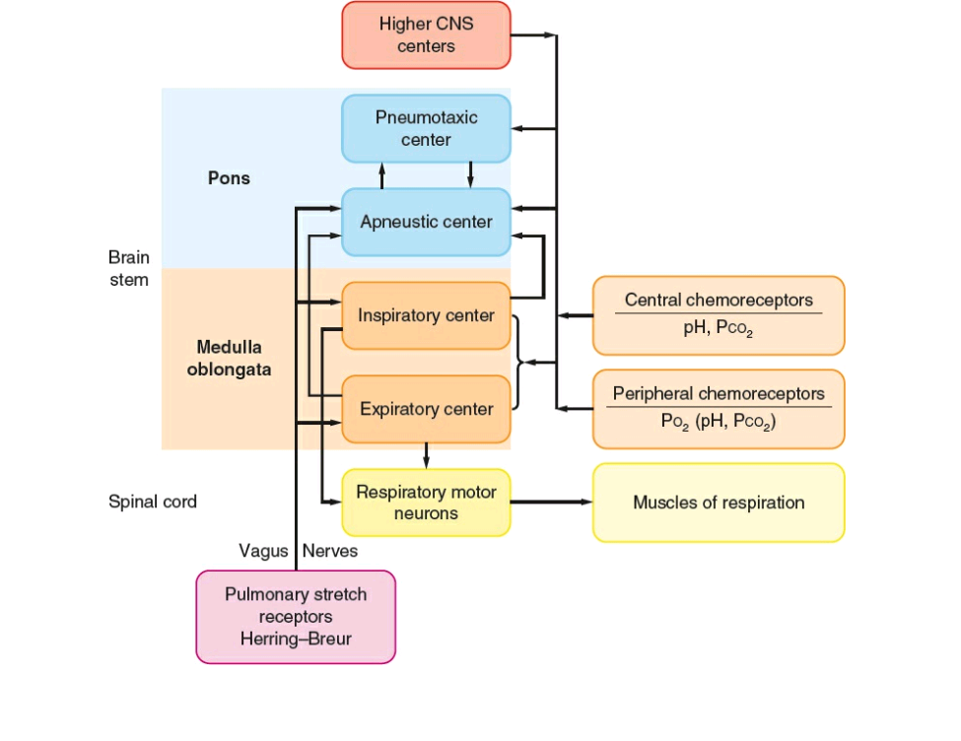
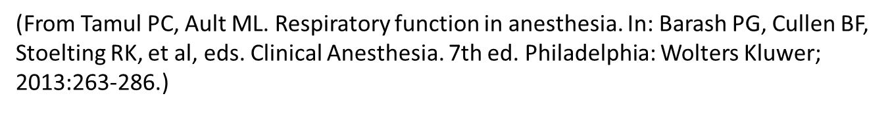
Regulation of Breathing…
Notes:
The respiratory center is located in the brainstem (both the pons and medulla). Breathing depends on a small area of the medulla near the origin of the vagus nerves. The dorsal medullary reticular formation contains the dorsal respiratory group (DRG), which contains the inspiratory centers. Ventilatory rhythmicity is generated by the DRG.
The ventral respiratory group is located in the ventral medullary reticular formation and coordinates expiratory efforts.
The apneustic center is located in the middle or lower pons and sends impulses to the DRG to sustain inspiration.
The pneumotaxic respiratory center is located in the rostral pons, and its function is to limit the depth of inspiration.
Both carotid and aortic bodies comprise the peripheral chemoreceptors. Carotid bodies are located at the bifurcation of the common carotid artery, whereas aortic bodies are located throughout the aortic arch and its branches. , the peripheral chemoreceptors respond primarily to lack of oxygen, and the central nervous system (CNS) receptors respond primarily to changes in PCO2, pH, and acid–base disturbances. The neural output from the carotid body reaches the central respiratory centers via the afferent glossopharyngeal nerves. Output from the aortic bodies travels to the medullary centers via the vagus nerve
Both carotid and aortic bodies are stimulated by decreases in PaO2. PaO2 values less than 100 mm Hg lead to increased neural activity from these receptors, but augmentation of minute ventilation (via increased ventilatory rate and TV) does not occur until PaO2 falls to 60-65 mm Hg.
Although the central response is a contributing factor in regulation of breathing by carbon dioxide, central chemoreceptors are actually primarily sensitive to changes in hydrogen ion concentration. Carbon dioxide’s effect is indirect—it reacts with water to form carbonic acid and thus hydrogen and bicarbonate ions when dissociated. Reference: 1. Tamul PC, Ault ML. Respiratory function in anesthesia. In: Barash PG, Cullen BF, Stoelting RK, et al, eds. Clinical Anesthesia. 7th ed. Philadelphia: Wolters Kluwer; 2013:263-286

Slide 21
Pulmonary Gas Exchange
The efficiency with which O2 and CO2 exchange at the alveolar–capillary level highly depends on
the matching of capillary perfusion and alveolar ventilation.
The adequacy of gas exchange in the lungs is determined by:
the balance between pulmonary ventilation and capillary blood flow
ventilation-perfusion (V/Q) ratio
Notes:
Ventilation is the bulk movement of gas into and out of the tracheobronchial tree

Slide 22
Distribution of Ventilation and Perfusion
Distribution of Ventilation
Alveolar pressure is the same throughout the lung; therefore,
the more negative intrapleural pressure at the apex (or the least gravity-dependent area) results in larger, more distended apical alveoli than in other areas of the lung
The transpulmonary pressure (Paw - Ppl), or distending pressure of the lung,
is greater at the top and lower at the bottom; where intrapleural pressure is less negative.
Despite the smaller alveolar size, more ventilation is delivered to dependent pulmonary areas.

Slide 23
Cont…
Distribution of Blood Flow
Blood flow within the lung is mainly gravity dependent
Because the alveolar– capillary beds are not composed of rigid vessels,
the pressure of the surrounding tissues can influence the resistance to flow through the individual capillaries
Thus, blood flow depends on the relationship between
pulmonary artery pressure (Ppa),
alveolar pressure (PA), and
pulmonary venous pressure (Ppv)
Notes:
Because the alveolar– capillary beds are not composed of rigid vessels, the pressure of the surrounding tissues can influence the resistance to flow through the individual capillaries. Thus, blood flow depends on the relationship between pulmonary artery pressure (Ppa), alveolar pressure (PA), and pulmonary venous pressure (Ppv)

Slide 24
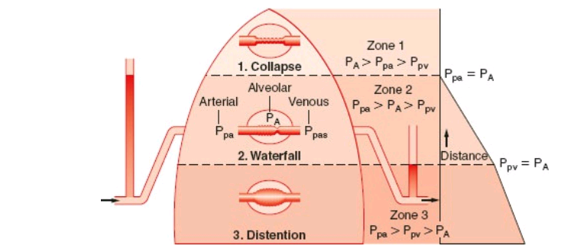
The West lung zone model
From Tamul PC, Ault ML. Respiratory function in anesthesia. In: Barash PG, Cullen BF, Stoelting RK, et al, eds. Clinical Anesthesia. 8th ed. Philadelphia: Wolters Kluwer; 2017:965-967

Slide 25
Cont…
Zone 1
Conditions occur in the most gravity-independent part of the lung (lung apex).
PA ≈ Patm.
PA > Ppa > Ppv.
PA transmitted to the pulmonary capillaries promotes their collapse, with a consequent theoretical blood flow of zero to this lung region.
Thus, Zone 1 receives ventilation in the absence of perfusion.
This relationship is referred to as alveolar dead space ventilation.
Normally, Zone 1 areas exist only to a limited extent.
However, in conditions of decreased Ppa, such as hypovolemic shock,
Zone 1 enlarges, thus increasing alveolar dead space ventilation.
Notes:
Zone 1 conditions occur in the most gravity-independent part of the lung (lung apex). In this region, alveolar pressure is approximately equal to atmospheric pressure.
Pulmonary artery pressure always exceeds pulmonary venous pressure, which is subatmospheric in Zone 1. Therefore, Zone 1 can be described by the following relationship: PA > Ppa > Ppv.

Slide 26
Cont…
Zone 2
Occurs from the lower limit of Zone 1 to the upper limit of Zone 3,
where Ppa > PA > Ppv.
Ppa-PA difference determines blood flow in Zone 2
Well-matched ventilation and perfusion occur in Zone 2, which contains the majority of alveoli.

Slide 27
Cont.…
Zone 3
occurs in the most gravity-dependent areas of the lung
where Ppa > Ppv > PA and
blood flow is primarily governed by the Ppa to PpV difference
Because gravity also increases Ppv, the pulmonary capillaries become distended.
Thus, perfusion in Zone 3 is lush, resulting in capillary perfusion in excess of ventilation, or physiologic shunt.

Slide 28
Cont…
Ventilation–Perfusion Relationships
The majority of blood flow is distributed to the gravity-dependent part of the lung.
During a spontaneous breath, the largest portion of the TV also reaches the gravity-dependent part of the lung.
Thus, the nondependent area of the lung receives a lower proportion of both ventilation (VA) and perfusion (Q), and
dependent lung receives greater proportions of ventilation and perfusion.
Nevertheless, ventilation and perfusion are not matched perfectly, and various V˙/Q˙ ratios result throughout the lung

Slide 29
Cont…
The ideal V˙/Q˙ ratio of 1 is believed to occur at approximately the level of the third rib.
Above this level, ventilation occurs slightly in excess of perfusion,
whereas below the third rib the V˙/Q˙ ratio becomes less than 1

Slide 30
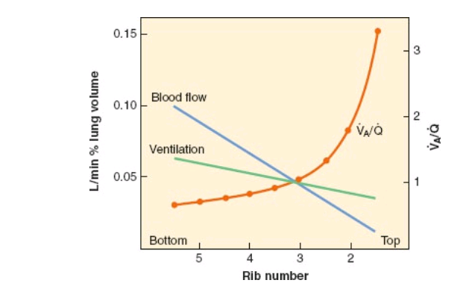
Cont…
Figure 15-6 Distribution of ventilation, blood flow, and ventilation–perfusion ratio in the normal, upright lung.

Slide 31
Cont…
In a simplified model, gas exchange units can be divided into
normal (V˙/Q˙ 1:1),
dead space (V˙/Q˙ = 1:0),
shunt (V˙/Q˙ = 0:1), or
a silent unit (V˙/Q˙ =0:0)
In the lungs of a healthy, upright, spontaneously breathing individual,
the majority of alveolar–capillary units are normal gas exchange units.
The V˙/Q˙ ratio varies between absolute shunt (in which V˙/Q˙ = 0) to absolute dead space (in which V˙/Q˙ = ∞ ).
Rather than absolute shunt, most units with low V˙/Q˙ mismatch receive a small amount of ventilation relative to blood flow.
Similarly, most dead space units are not absolute, but rather are characterized by low blood flow relative to ventilation.

Slide 32
Cont…
A V/Q ratio above 1 describes the condition where ventilation is excessive relative to capillary blood flow.
The excess ventilation, known as dead space ventilation, does not participate in gas exchange with the blood.
There are two types of dead space ventilation (VD).
Anatomic dead space
It is the gas in the large conducting airways that does not come in contact with capillaries (2ml/kg of ideal body weight)
It is the fraction of the VT that remains in the “conducting” airways,
50% is in the pharynx.
It accounts for the majority of physiologic dead space
Notes:
Anatomical Dead-space
The space within the conducting airways (from the mouth and the nose down to the terminal bronchi) constitutes the anatomical dead-space. Conducting airways merely conduct air down to the respiratory zone of the lung, and by themselves, play no role in gas exchange. The volume of the conducting airways is approximately 150 mL in an adult. Thus, of a tidal breath of 450 mL, only 300 mL will participate in gas exchange, 150 Ml being contained within the dead-space. This 150 mL of anatomical dead-space can be cut down to about 40-60% by tracheotomy.
Clinical conditions that modify anatomic dead space include tracheal intubation, tracheostomy, and large lengths of ventilator tubing between the tracheal tube and the ventilator Y piece.
In contrast, the inspiratory or expiratory limb of the anesthesia circle system has unidirectional flow, and therefore, is not a component of anatomic dead space ventilation.

Slide 33
Cont…
Physiologic dead space
It is the alveolar gas that does not equilibrate fully with capillary blood or
it is any part of a VT that does not participate in gas exchange
In normal subjects, VD accounts for 20 -30% of the total ventilation (VT), so VD/VT = 0.2 to 0.3

Slide 34
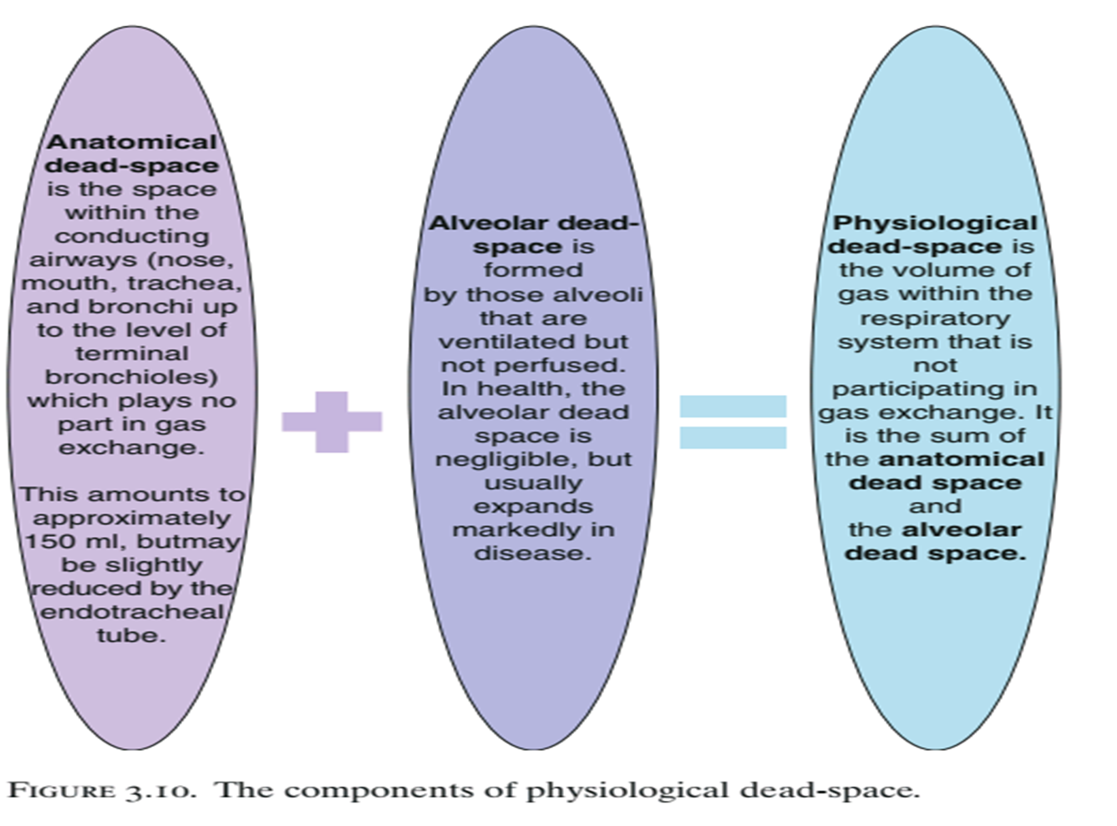
Notes:
Alveolar dead space;-This occurs when areas of the lung are being ventilated but not being perfused and this leads to what is known as V/Q mismatch
Alveolar dead space ventilation arises from ventilation of alveoli with inadequate or no perfusion

Slide 35
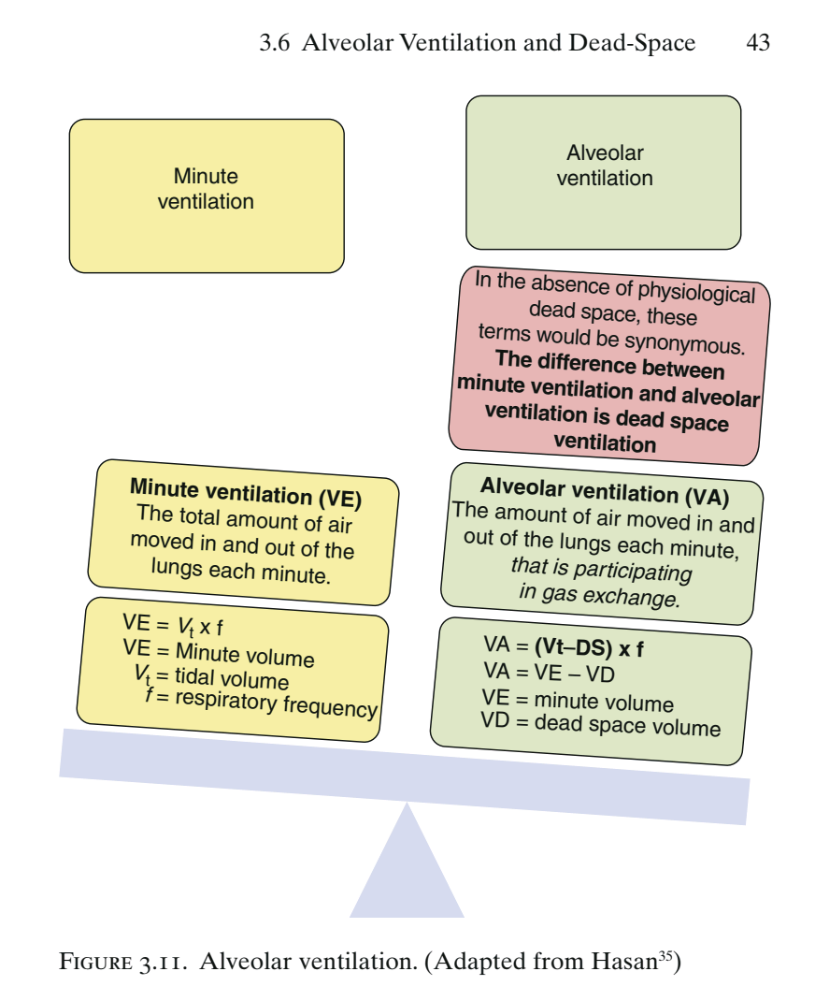
Cont…
Notes:
Minute ventilation is the product of the tidal volume times the respiratory rate: it is inversely proportional to the PaCO2. The minute ventilation also affects the PaO2 in a nonlinear fashion; however, manipulating the minute volume for the purposes of achieving a change in PaO2 is undesirable, as only small changes in PaO2 can be brought about by large alterations in minute ventilation. Such large changes in minute ventilation can have a profound and unwanted effect on PaCO2.
Manipulation of tidal volumes has a different effect on the PaCO2 than does altering respiratory rate.

Slide 36
Cont…
Dead space ventilation increases when:
the alveolar–capillary interface is destroyed (e.g., emphysema),
blood flow is reduced (e.g., low cardiac output), or
alveoli are over distended (e.g., positive-pressure ventilation).
Notes:
Increases in dead space ventilation primarily affect carbon dioxide elimination and have little influence on arterial oxygenation until dead space ventilation exceeds 80% to 90% of minute ventilation ( E).
Similarly, physiologic shunt primarily affects arterial oxygenation with little effect on carbon dioxide elimination until the physiologic shunt fraction exceeds 75% to 80% of the cardiac output.

Slide 37
Cont…
A V/Q ratio below 1 describes the condition where capillary blood flow is excessive relative to ventilation.
The excess blood flow, known as intrapulmonary shunt, does not participate in pulmonary gas exchange.
Notes:
When ventilation exceeds perfusion to a significant amount, it is called dead space .
When there is no ventilation or perfusion, it is defined as a silent unit. This could theoretically be the result of a combination of a pulmonary vaso-hypoxic response in addition to a pulmonary bronchiolar constrictive response. When a unit has no ventilation but there is blood flow, it is called a shunt Reference: 1. Tamul PC, Ault ML. Respiratory function in anesthesia. In: Barash PG, Cullen BF, Stoelting RK, et al, eds. Clinical Anesthesia. 7th ed. Philadelphia: Wolters Kluwer; 2013:263-286.

Slide 38
Cont…
Shunt
blood reaching the systemic circulation without being oxygenated via passage through the lungs.
True shunt (anatomical shunt)
the total absence of exchange between capillary blood and alveolar gas (V/Q = 0); passes through an anatomic channel of the heart and does not pass through the lungs. E.g. VSD
Intrapulmonary shunt
blood flows through pulmonary capillaries without participating in gas exchange. E.g. alveoli filled with fluid
Notes:
The physiologic shunt (Q˙ SP) is that portion of the total cardiac output (Q˙T) that returns to the left heart and systemic circulation without receiving oxygen in the lung. Because blood passing through areas of absolute shunt receives no oxygen, arterial hypoxemia resulting from absolute shunt is minimally reversed with supplemental oxygen.
Alternatively, supplemental oxygen supplied to patients with arterial hypoxemia due to venous admixture will increase the PaO2.

Slide 39
Cont…
The fraction of the cardiac output that represents intrapulmonary shunt is known as the shunt fraction.
In normal subjects, intrapulmonary shunt flow (Qs) represents less than 10% of the total cardiac output (Qt),
So, the shunt fraction (Qs/Qt) is less than 10%
Notes:
A small percentage of venous blood normally bypasses the right ventricle and empties directly into the left atrium. This anatomic, absolute, or true shunt arises from the venous return of the pleural, bronchiolar, and thebesian veins. This venous admixture accounts for 2% to 5% of total cardiac output and represents the small shunt that normally occurs. An anatomic shunt occurs when blood travels from the right side of the heart to the left side of the heart via anatomic structures that bypass the alveoli. Normally, a small amount of venous blood is carried from the bronchial veins, Thebesian veins, and pleural veins to the left side of the heart where it mixes with oxygenated blood from the pulmonary circulation. This normal venous admixture (i.e., anatomic shunt) represents 2%–5% of the cardiac output and explains why arterial oxygen tension (PaO2) is slightly less than pulmonary capillary oxygen tension (Pc´O2).
An abnormal anatomic shunt can occur with certain congenital cardiac defects (e.g., cardiac septal defects, tetralogy of Fallot) or cases of persistent fetal circulation (e.g., patent ductus arterious [PDA] or patent foramen ovale).
Large anatomic shunts may cause severe hypoxemia that is refractory to oxygen administration.

Slide 40
Cont…
Conditions which increases intrapulmonary shunt fraction:
occlusion of small airways (e.g., asthma),
when alveoli are filled with fluid (e.g., pulmonary edema, pneumonia)
when alveoli collapse (e.g., atelectasis), or
when capillary flow is excessive (e.g., non embolized regions of lung in pulmonary embolism)

Slide 41
Cont…
The PaO2 falls progressively as shunt fraction↑,
but the PaCO2 remains constant until the shunt fraction exceeds 50%.
The PaCO2 is often below normal in patients with increased intrapulmonary shunt as a result of:
hyperventilation triggered by the disease process (e.g., sepsis) or by the accompanying hypoxemia.

Slide 42
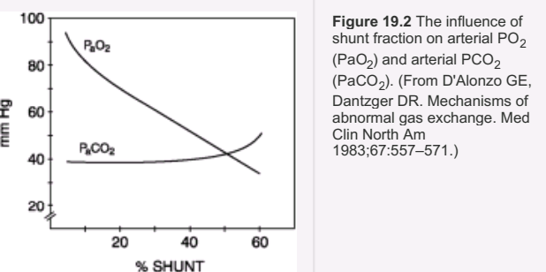
Cont…

Slide 43
Cont…
Inhaled Oxygen
The Qs/Qt also determines the influence of inhaled oxygen on PaO2.
As intrapulmonary shunt increases from 10 to 50%, an increase in FiO2 produces less of an increment in the PaO2.
When the Qs/Qt exceeds 50%, the PaO2 is independent of changes in FiO2, and the condition behaves like a true (anatomic) shunt.
This means that, in conditions associated with a high Qs/Qt (e.g., acute respiratory distress syndrome), the FiO2 can often be lowered to non-toxic levels (FiO2 below 50%) without further compromising arterial oxygenation.
This can be a valuable maneuver for preventing pulmonary oxygen toxicity.

Slide 44
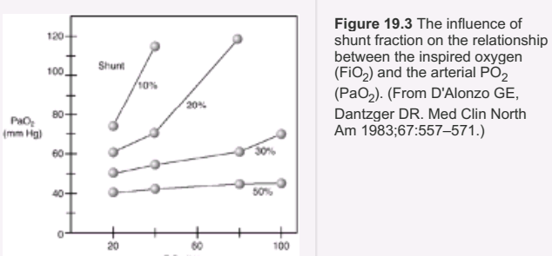
Cont…

Slide 45
Respiratory failure

Slide 46
Definition
Respiratory failure is defined as an inability of the heart and lungs to provide adequate tissue oxygenation and/or CO2 removal
It refers to the inadequate exchange of gas by the cardiopulmonary system
It may be defined as impairment of normal gas exchange severe enough to require acute therapeutic intervention
It is “inability to maintain either normal delivery of O2 to the tissues or the normal removal of CO2 from the tissues”
Failure of gas exchange due to inadequate function of one or more essential components of respiratory system

Slide 47
Cont…
It is conventionally defined by
an arterial O2 tension (PaO2) of <8.0 kPa (60 mmHg),
an arterial CO2 tension (PaCO2) of >6.0 kPa (45 mmHg) or
both

Slide 48
Interactive question 3
What is the difference between respiratory failure vs ventilatory failure?
Ventilatory failure: it is defined as an elevated PaCO2 > 45–50 mmHg.
Other terms sometimes used to describe an elevated PaCO2 (i.e., ventilatory failure) include
hypoventilation, hypercapnea, and respiratory acidosis.

Slide 49
Types of respiratory failure
In order to distinguish between the types of respiratory failure, it is useful to determine the difference between:
PAO2 and PaO2, or P(A-a)O2.
The PaCO2 is obtained from an arterial blood gas, whereas the PAO2 is calculated from the alveolar gas equation:
PAO2 = PIO2- (PaCO2 /RQ )
where PIO2= (PB - PH2O)FIO2 =150 mmHg
RQ = VCO2/VO2=0.8 where; VCO2 is normally about 200 mL/min, VO2 is approximately 250 mL/min.
PAO2 = (PB - PH2O)FIO2 - PaCO2 /RQ
Notes:
RQ is generally indicative of the primary type of fuel being utilized; i.e. carbohydrates, lipids, and proteins. The CO2 tension in the atmospheric air is negligible. In contrast, the level of CO2 in alveolar air is substantial, exerting a partial pressure of approximately 40 mmHg.
The alveolo-capillary membrane is highly permeable to CO2, and as a result of this, the partial pressure of the CO2 in alveolar air is almost identical to the partial pressure of CO2 in alveolar capillary blood.

Slide 50
Cont…
P(A-a)O2= PAO2 – PaO2
[(PB - PH2O)FIO2 – (PaCO2 /RQ)] - PaO2
In a healthy subject breathing room air at sea level,
FiO2 = 0.21, PB = 760 mm Hg, PH2O = 47 mm Hg, PaO2 = 90 mm Hg, PaCO2 = 40 mm Hg, and RQ = 0.8:
P(A-a)O2= 10 mmHg
Therefore, normal P(A-a)O2 when a person is breathing room air is less than 15 mm Hg and increases linearly with age and FIO2.
In a person 80 years of age breathing room air, a normal P(A-a)O2 is 25 mm Hg; when breathing an FIO2 of 1.0, a P(A-a)O2 of 60 is normal.

Slide 51
Types of respiratory failure…
Acute respiratory failure (ARF)
Chronic respiratory failure
It is a sudden decrease in arterial oxygenation with or without CO2 retention (i.e., with or without hypercapnia [PaCO2 > 45 mmHg]).
PaO2 < 50–60 mmHg;
SaO2 < 88–90%
Patients may have hypoxemia alone or hypoxemia with hypercapnia
Common causes requiring mechanical ventilation:
ARDS, aspiration, heart failure, pneumonia, postoperative failure, sepsis, and trauma.
It is a long-term condition, usually occurring over a period of months or years.
It generally is due chronic lung disease, such as COPD, cystic fibrosis, or pulmonary fibrosis.
Other causes: Neuromuscular disease, spinal cord injury, chest wall abnormalities, and obesity–hypoventilation syndrome
Notes:
Patients with acute respiratory failure may have hypoxemia alone or hypoxemia with hypercapnia. Neuromuscular disease, spinal cord injury, chest wall abnormalities, and obesity–hypoventilation syndrome may also cause chronic respiratory failure.

Slide 52
Types of respiratory failure…
Hypoxemic respiratory failure aka lung failure or type I respiratory failure
It is a primary problem with arterial oxygenation
It is typically caused by problems with gas exchange in the lung
a significant impairment in the molecular exchange of oxygen across the pulmonary alveolar-capillary membrane,
causing a decrease in PaO2 < 60 mmHg,
with a normal or low PaCO2 and an increase in P(A-a)O2
This is the most common form of respiratory failure
It can be associated with virtually all acute diseases of the lung, which generally involve fluid filling or collapse of alveolar units
Notes:
Respiratory failure can thus be conceptualized as having components of ventilatory pump failure (failure to adequately move gases in and out of the pulmonary system) and/or lung failure

Slide 53
Type I respiratory failure…
It is primarily caused by V/Q Mismatch
Common causes of hypoxemic respiratory failure include
atelectasis, pneumonia, and pulmonary edema
N.B.
ARDS is a type of hypoxemic respiratory failure due to noncardiogenic pulmonary edema.
Notes:
Oxygenation problems in the lung may be caused by poor matching of gas and blood (e.g., pulmonary shunt or low ventilation to perfusion ratios [low V̇/Q̇]), diffusion problems (e.g., early pulmonary fibrosis), and hypoventilation, in which an increased alveolar
carbon dioxide tension (PACO2) reduces alveolar and arterial oxygen tensions (i.e., decreased PAO2 and PaO2).

Slide 54
Types of respiratory failure…
Type I respiratory failure occurs because of damage to lung tissue.
This lung damage prevents adequate oxygenation of the blood (hypoxaemia);
however, the remaining normal lung is still sufficient to excrete the carbon dioxide being produced by tissue metabolism.
This is possible because less functioning lung tissue is required for CO2 excretion than is needed for oxygenation of the blood.

Slide 55
Types of respiratory failure……
Hypercapnic respiratory failure (pump failure) aka ventilatory (type II) respiratory failure
It refers to a primary problem with ventilation
It is simply defined as an abnormally elevated PaCO2.
a decrease in the bulk flow of gas in and out of the lungs resulting in alveolar hypoventilation and retention of CO2.
This rise in CO2 is frequently accompanied by a drop in the PaO2 but with a normal P(A-a)O2 .
It occurs when alveolar ventilation is insufficient to excrete the carbon dioxide being produced.
Notes:
In the absence of underlying pulmonary disease, hypoxaemia accompanying hypoventilation is characterized by normal gradient between alveolar and arterial oxygen tension (P(A-a) O2 gradient.

Slide 56
Type II respiratory failure……
Inadequate ventilation is due to reduced ventilatory effort, or inability to overcome increased resistance to ventilation –
it affects the lung as a whole, and thus carbon dioxide accumulates.
The most common cause is chronic obstructive pulmonary disease (COPD).
Notes:
As ventilation increases, arterial carbon dioxide levels decrease and vice versa. Thus, arterial carbon dioxide tension (PaCO2) is the single best index of alveolar ventilation.

Slide 57
Type II respiratory failure classification
Acute ventilatory failure (AVF)
Chronic ventilatory failure
a sudden increase in arterial PaCO2 with a corresponding decrease in pH..
Causes :
decreased respiratory drive, airway obstruction, an increased work of breathing, or respiratory muscle fatigue
It is defined as a chronically elevated PaCO2, with a normal or near-normal pH owing to metabolic compensation.
Common cause:
COPD, although not all patients with COPD develop it.
It is also seen in patients with late-stage cystic fibrosis, severe interstitial lung disease, and obesity–hypoventilation syndrome
Notes:
With the exception of acute exacerbation of chronic lung disease, patients with chronic ventilatory failure generally do not require mechanical ventilatory support unless there is an acute insult.
Causes of an increased work of breathing and respiratory muscle fatigue include severe pneumonia, ARDS, heart failure (aka congestive
heart failure or CHF), and pulmonary edema. Other causes may include shock, trauma, smoke or chemical inhalation, aspiration, and near-drowning. Causes of decreased respiratory drive include general anesthesia, sedative or narcotic drug overdose, head trauma, or stroke.

Slide 58
Type II respiratory failure classification…
Acute ventilatory failure superimposed on chronic ventilatory failure
A chronically elevated PaCO2 followed by an acute increase in PaCO2 and a corresponding decrease in pH.
For example, a COPD patient with chronic ventilatory failure may acutely develop pneumonia, resulting in a further increase in PaCO2.
Patients may require mechanical ventilatory support

Slide 59
Types of respiratory failure……
Combined ventilatory and hypoxic respiratory failure
Manifests with
a low PaO2,
an elevated PaCO2
as well as an increased P(A-a)O2.
Notes:
Chronic obstructive pulmonary disease (COPD) is currently defined as a disease state characterized by airflow limitation that is not fully reversible

Slide 60
Cont.…
Impending ventilatory failure
It is a category in which hypoventilation and hypercapnia are not yet present but
are likely to occur in the immediate future if no action is taken.
For example, adult patients with
markedly increased respiratory rates (> 35 breaths/min),
hyperventilation (i.e., decreased PaCO2),
severe distress, accessory muscle use, diaphoresis, and air hunger may rapidly progress to a state of severe hypoventilation and possible respiratory arrest.
Notes:
Severe respiratory distress with air hunger, sweating, accessory muscle use, and significantly increased
respiratory rate (>35 breaths/min in adults) may signal an impending respiratory arrest.

Slide 61
Inhaling
Affects PaO2
Exhaling
Affects PCO2

Slide 62
Causes of Respiratory failure
Hypoxemic Respiratory Failure
Diseases that damage lung tissues: pulmonary edema, pneumonia, ARDS, and chronic pulmonary fibrosing alveolitis.
Oxygenation problems
V/Q Mismatch
Shunt
Diffusion Limitation
Alveolar Hypoventilation- increased CO2 and decreased PO2

Slide 63
Causes of Respiratory failure…
V/Q mismatch
Normal ventilation of alveoli is comparable to amount of perfusion
Normal V/Q ratio = 0.8-1
V/Q Mismatch can be due to:
Inadequate ventilation, poor perfusion
Obstruction
Fluid filled alveoli
Atelectasis
COPD
Pneumonia
Asthma
Pulmonary embolus
ARDS

Slide 64
Causes of Respiratory failure…
Even in normal lungs → areas present where V/Q mismatching is present
→ i.e., V/Q - ↑ at apex
- ↓ at bases
But overall, a balance is maintained to achieve a steady ratio of ‘0.8’ for the whole lung (in healthy lungs).
In certain pathological states, the imbalance occurs leading to hypoxemia and V/Q mismatching.

Slide 65
Cont.…
Shunt
blood reaching the systemic circulation without being oxygenated via passage through the lungs
Anatomic shunt
Normal anatomical shunt: 2-3% in bronchial and thebesian veins
Intrapulmonary shunt: No ventilation with respect to pulmonary perfusion
Examples: ARDS, atelectasis, pneumonia, rarely pulmonary edema.
Pathological Shunt
Pathological anatomical shunt
R → L blood flow through cardiac openings (e.g. ASD/VSD) or in pulmonary A-V malformations
Physiological anatomical shunt- Atelectasis, pulmonary edema, or pneumonia → does not generally respond to O₂ supplementation as the gas exchange units are completely closed / collapsed (the alveolus)
Notes:
Shunt- is blood reaching the systemic circulation without being oxygenated via passage through the lungs
Thebesian veins-smallest cardiac veins-are minute valveless veins in the walls of all 4 heart chambers and abundant in the rt. atrium. They drain directly into the left cardiac chambers.
Bronchial veins-supply conducting airways of the lungs-
Physiological shunt-shunting of blood from the right side of the circulation containing deoxygenated blood to the left side of the heart (circulation) containing oxygenated blood.

Slide 66
Cont…
Diffusion Limitation/problems
Diffusion: It is a passive movement of molecules (gases) across the alveolar-capillary membrane as a result of difference in pressure gradient.
Any impairment in diffusion leads to inability of O2 to pass to the arterial blood, thereby lowering the PaO2.
E.g. Emphysema, pulmonary vascular abnormality, anaemia, pulmonary HTN
Notes:
Shunting denotes the process whereby desaturated, mixed venous blood from the right heart returns to the left heart without being resaturated with O2 in the lungs
Diffusion” refers to the passive movement of molecules across a membrane that is governed primarily by concentration gradient. Carbon dioxide is 20 times more diffusible across human membranes than is oxygen; therefore, carbon dioxide crosses alveoli easily. Diffusion of oxygen across the alveolar–capillary membrane can be impaired (known as diffusion limitation) due to mismatch of ventilation and perfusion, a reduction in the available surface area for diffusion, or an increase in diffusion distance.
Interstitial lung disease (ILD) may cause inflammation, edema, and interstitial fibrosis and thus increase the distance oxygen must travel from the alveolus to the adjacent pulmonary capillary. Other causes of diffusion problems include pulmonary vascular disease, emphysema, and alveolar or interstitial edema. With impaired diffusion, hypoxemia may only occur during exercise; hypoxemia due to a diffusion defect is typically reversible by the administration of low to moderate concentrations of oxygen.

Slide 67
Cont…
Diffusion limitation can be due to:
V/Q mismatch, a reduction in the available surface area for diffusion, or an increase in diffusion distance.
Gas exchange is compromised by a process that thickens or destroys the membrane
Pulmonary fibrosis
ARDS
* A classic sign of diffusion limitation is hypoxemia during exercise but not at rest

Slide 68
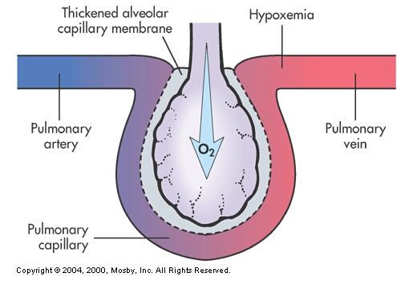
Diffusion Limitation…

Slide 69
Cont…
Alveolar Hypoventilation: increased PCO2 with decreased PO2
Mainly due to hypercapnic respiratory failure but can cause hypoxemia.
Restrictive lung diseases
CNS diseases
Neuromuscular diseases

Slide 70
Causes of Respiratory failure…
Hypercapnic Respiratory Failure (Ventilation problems)
Imbalance between ventilatory supply and demand
Features
Elevated PaCO_{2:} creating an uncompensated respiratory acidosis
PaCO₂ 1/α alveolar ventilation
α VD / VT
α CO₂ production
Hypoxemia occurs due to displacement of alveolar PO₂ by ↑ CO₂

Slide 71
Cont.…
Abnormalities of the airways and alveoli: air flow obstruction and air trapping
Asthma, COPD, and cystic fibrosis
Abnormalities of the CNS: suppresses drive to breath
Drug over dose, narcotics, head injury, spinal cord injury
Abnormalities of the chest wall
Flail chest, morbid obesity, kyphoscoliosis
Neuromuscular Conditions- respiratory muscles are weakened
Guillain-Barre, muscular dystrophy, myasthenia gravis and multiple sclerosis

Slide 72
Clinical Manifestations of Respiratory Failure
Tachycardia, tachypnea,
accessory muscle use, intercostal retractions,
nasal flaring (especially in infants and children),
diaphoresis, and O2 desaturation.
Excitement, overconfidence, restlessness,
anxiety, nausea, headache, and
altered mental status may be present, followed by confusion, somnolence, and coma as the patient’s condition deteriorates.

Slide 73
Clinical Manifestations of Respiratory Failure….
Rapid, shallow breathing is a common finding.
Severe respiratory failure may be signaled by
slowed or irregular breathing,
reduced chest expansion,
cardiac arrhythmias, and hypotension.
Cyanosis is a variable finding and may not be present in patients with anemia.

Slide 74
Cont.…
Signs and Symptoms of Respiratory Failure
Early signs
Tachycardia and mild hypertension
Severe morning headache
Late sign
Cyanosis
Consequences of hypoxemia and hypoxia
Metabolic acidosis and cell death
Decreased cardiac output
Impaired renal function

Slide 75
Assessment of Respiratory Failure
History and physical assessment
ABG analysis
Chest x-ray
CBC, sputum/blood cultures, electrolytes
ECG
Urinalysis
V/Q lung scan
Pulmonary artery catheter (severe cases)

Slide 76
Cont…
History
e.g., previous cardiac disease, VHD, recent symptom of orthopnea, chest pain
Trauma
Aspiration
Sepsis
Infection, etc.

Slide 77
Cont…
Signs of underlying disease process – pneumonia, pulmonary edema, asthma, COPD, cor pulmonale etc.
Hypoxemia- restlessness, anxiety, confusion, somnolence, tachycardia, dyspnea, cyanosis, use of accessory muscles, arrhythmias, seizures etc.
Hypercapnia, tachycardia, hypertension etc.

Slide 78
Cont.…
Assessment for Respiratory Failure
Evaluation of patients in respiratory failure must include:
a thorough assessment of oxygenation and carbon dioxide removal (i.e., ventilation).
When the clinical manifestations are present,
the patient’s PaO2 and PaCO2 levels should be assessed.
Pulse oximetry provides an inexpensive, fast, safe, and convenient method to assess SpO2.
However, it may not detect certain types of hypoxia, including anemic hypoxia, circulatory hypoxia, ischemic hypoxia, and histotoxic hypoxia.

Slide 79
Cont.…
Oxygenation
The oxygenation process begins with
the inspired gas and moves to the conducting airways,
matching of gas and blood in the lung,
diffusion of oxygen across the alveolar-capillary membrane, and
loading of the arterial hemoglobin with oxygen.

Slide 80
Steps in the Oxygenation Process
In order for tissue oxygenation to be adequate, the following must occur:
PIO2 must be sufficient. PIO2 is determined by barometric pressure (e.g., altitude) and FIO2.
Oxygen must be conducted to the alveolar level, which requires clear and patent conducting airways.
There must be adequate alveolar ventilation (V̇ A).
Matching of gas and blood in the alveoli and adjacent pulmonary capillaries must occur.
Oxygen must diffuse across the alveolar capillary membrane into the blood.
The arterial blood oxygen content (CaO2) must be adequate,
which requires adequate PaO2, SaO2 (dependent on PaO2, chemical environment of the blood

Slide 81
Cont…
Physical examination and diagnostic evaluation
Disease specific- Hgb, LFT, RFT, Serum electrolytes, Thyroid profile
ABG remains the confirmatory diagnostic tool
PaO2, PaCO2, A-aDO2, pH, HCO3
O2 saturation
Radiological tools- CXR, CT- chest, V/Q scan, ECHO
Pulmonary function test- more useful in chronic respiratory failure

Slide 82
Diagnostic evaluation of respiratory failure
Hypoxemic Respiratory Failure
Hypoxemia
Compensatory Mechanisms- early
Tachycardia- more O2 to tissues
Hypertension- fight or flight
Tachypnea –take in more O2
Restlessness and apprehension
Dyspnea
Cyanosis
Confusion and impaired judgment
Later: dysrhythmias and metabolic acidosis, decreased. BP and Decreased CO.
Notes:
HPV is a compensatory mechanism that diverts blood flow away from hypoxic lung regions toward better oxygenated regions.

Slide 83
Cont…
Hypercapnia
Dyspnea to respiratory depression- if too high CO2 narcosis
Headache-vasodilation- Increases ICP
Papilledema
Tachycardia and increased B/P
Drowsiness and coma
Respiratory acidosis
**Administering O2 may eliminate drive to breathe especially in COPD patients- WHY??
Notes:
Breathing O2 can sometimes induce hypercapnia, as occurs in patients with severe chronic lung disease who are breathing supplemental O2. Although traditionally thought to occur because increased PaO2 reduces ventilatory drive, this is now thought not to be the case, resulting instead from the Haldane effect, as well as from impairment of hypoxic pulmonary vasoconstriction (HPV).
The Haldane effect is the difference in the amount of CO2 carried in oxygenated versus deoxygenated blood, and two mechanisms explain this. First, increased PaO2 decreases the ability to form carbamino compounds—reducing the amount of CO2 bound to Hb—thereby raising the amount of dissolved CO2 (i.e., elevated PCO2). Second, the amino acid histidine, which has an imidazole group that is an effective H+ buffer at physiologic pH, is an important linking molecule between heme groups and the Hb chains. Increasing the partial pressure of oxygen (PO2) increases the amount of O2 bound to Hb; this changes the conformation of the Hb molecule, which in turn alters the heme-linked histidine and reduces its H+ buffering capacity. Therefore, more H+ is free (not buffered) and binds to HCO3–, releasing stored CO2.
Impairment of HPV by elevated O2 allows increased perfusion to poorly ventilated regions; this has the effect of decreasing perfusion (and delivery of CO2) to better ventilated regions, diminishing the efficiency of CO2 exhalation.
Patients with impaired ability to increase alveolar ventilation (V˙ A) cannot compensate for the increased CO2 availability, and therefore, in these patients, adding supplemental O2 can result in elevated Paco2.

Slide 84
Management
Regardless of the disorder, the treatment of respiratory failure is primarily supportive
support of oxygenation, ventilation, circulation, and acid-base balance.
Hypoxemia is treated with oxygen therapy and positive airway pressure (if FRC is decreased),
Positive pressure ventilation (PPV)
Correction of hypoxemia- goal is to achieve a SaO2 of >90%, and a PaO2 of >60 mmHg
Supplemental oxygen
NIPPV
intubation and mechanical ventilation

Slide 85
Cont…
Hypercarbia (ventilatory failure)
treated with mechanical ventilation with or without intubation.
Other general measures may include:
using aerosolized bronchodilators,
intravenous antibiotics, and diuretics for ﬂuid overload,
therapy to improve cardiac function, and nutritional support

Slide 86
References
Tamul PC, Ault ML. Respiratory function in anesthesia. In: Barash PG, Cullen BF, Stoelting RK, et al, eds. Clinical Anesthesia. 8th ed. Philadelphia: Wolters Kluwer; 2017: 938-996
Ashfaq Hasan. Understanding Mechanical Ventilation: A Practical Handbook, 2nd Edition
Miller Anesthesia, 9th ed. Page 354-382

Slide 87
Thank you

